Slide 2
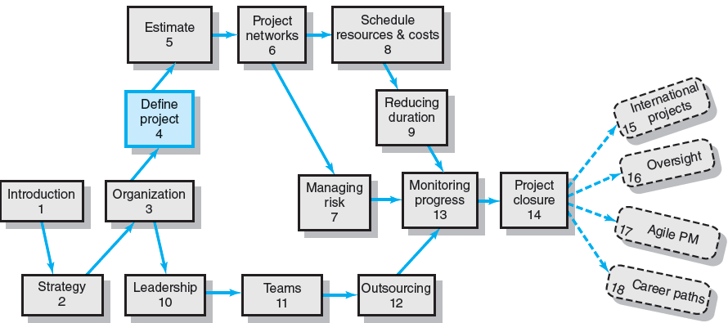
Where We Are Now

Slide 3
Chapter Objectives
To recognize the importance of a complete scope statement acceptable to your customer as a condition for project success
To layout guidelines for creating a WBS for a project
To demonstrate the importance of WBS to the management of projects and how it serves as a database for planning and control
To demonstrate how the OBS establishes accountability to organizational units
To apply a WBS to a case or suggested project
To recognize the process for setting up a communication plan.

Slide 4
Defining the Project
Step 1: Defining the Project Scope
Step 2: Establishing Project Priorities
Step 3: Creating the Work Breakdown Structure
Step 4: Integrating the WBS with the Organization
Step 5: Coding the WBS for the Information System

Slide 5
Step 1: Defining the Project Scope
Project Scope
A definition of the end result or mission of the project—a product or service for the client/customer—in specific, tangible, and measurable terms.
Purpose of the Scope Statement
To clearly define the deliverable(s) for the end user.
To focus the project on successful completion of its goals.
To be used by the project owner and participants as a planning tool and for measuring project success.

Slide 6
Project Scope Checklist
Project objective
Deliverables
Milestones
Technical requirements
Limits and exclusions
Reviews with customer

Slide 7
Project Scope: Terms and Definitions
Scope Statements
Also called statements of work (SOW)
Project Charter
Can contain an expanded version of scope statement
A document authorizing the project manager to initiate and lead the project.
Scope Creep
The tendency for the project scope to expand over time due to changing requirements, specifications, and priorities.

Slide 8
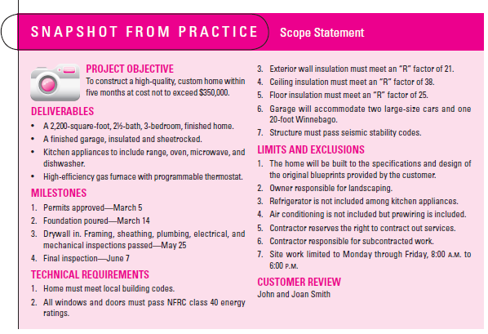
Scope Statements

Slide 9
Project Charters
After deciding what project to work on, it is important to let the rest of the organization know
A project charter is a document that formally recognizes the existence of a project and provides direction on the project’s objectives and management
Key project stakeholders should sign a project charter to acknowledge agreement on the need and intent of the project; a signed charter is a key output of project integration management

Slide 10
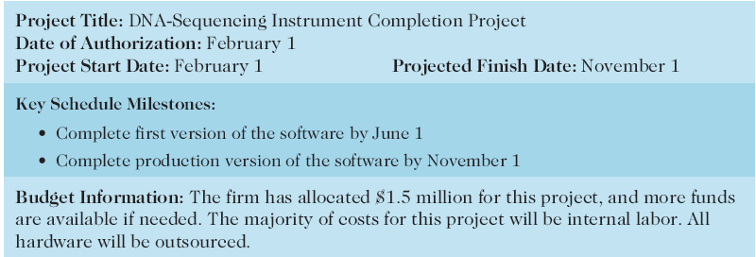
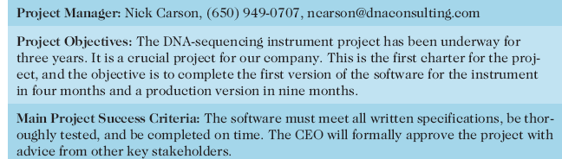
Table 4-1. Project Charter for the DNA-Sequencing Instrument Completion Project

Slide 11
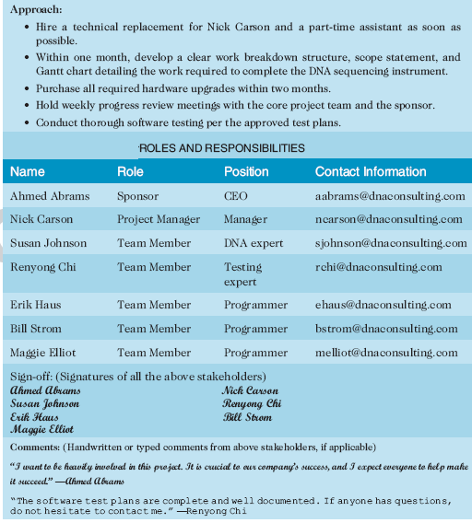
Table 4-1. Charter (continued)

Slide 12
Step 2: Establishing Project Priorities
Causes of Project Trade-offs
Shifts in the relative importance of criterions related to cost, time, and performance parameters
Budget–Cost
Schedule–Time
Performance–Scope
Managing the Priorities of Project Trade-offs
Constrain: a parameter is a fixed requirement.
Enhance: optimizing a criterion over others.
Accept: reducing (or not meeting) a criterion requirement.

Slide 13
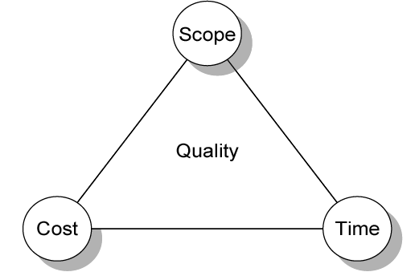
Project Management Trade-offs
FIGURE 4.1

Slide 14
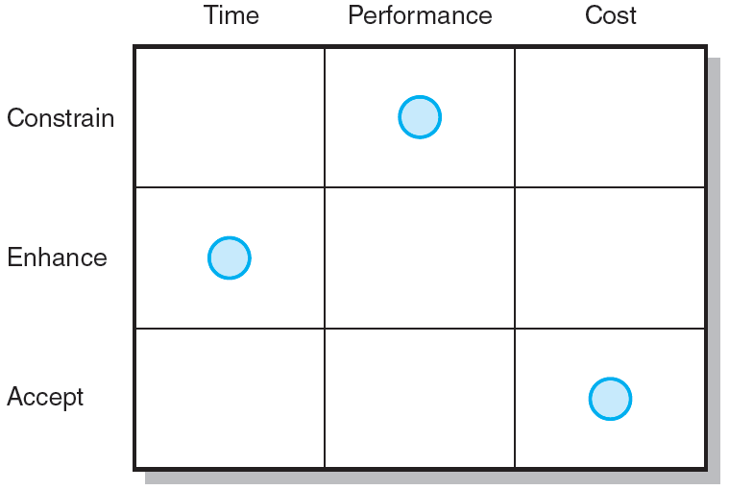
Project Priority Matrix
FIGURE 4.2

Slide 15
Step 3: Creating the Work Breakdown Structure
Work Breakdown Structure (WBS)
An hierarchical outline (map) that identifies the products and work elements involved in a project.
Defines the relationship of the final deliverable (the project) to its subdeliverables, and in turn, their relationships to work packages.
Best suited for design and build projects that have tangible outcomes rather than process-oriented projects.

Slide 16
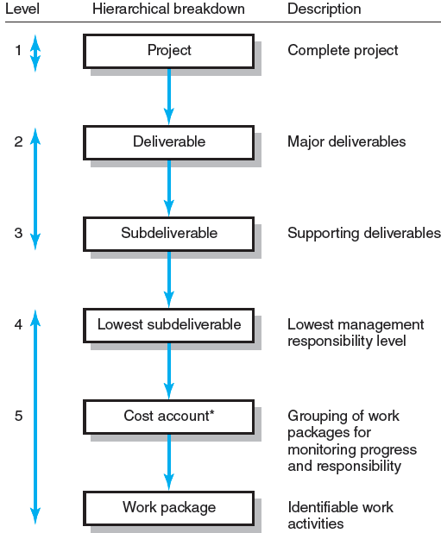
Hierarchical Breakdown of the WBS
* This breakdown groups work packages by type of work within a deliverable and allows assignment of responsibility to an organizational unit. This extra step facilitates a system for monitoring project progress (discussed in Chapter 13).
FIGURE 4.3

Slide 17
How WBS Helps the Project Manager
WBS
Facilitates evaluation of cost, time, and technical performance of the organization on a project.
Provides management with information appropriate to each organizational level.
Helps in the development of the organization breakdown structure (OBS). which assigns project responsibilities to organizational units and individuals
Helps manage plan, schedule, and budget.
Defines communication channels and assists in coordinating the various project elements.

Slide 18
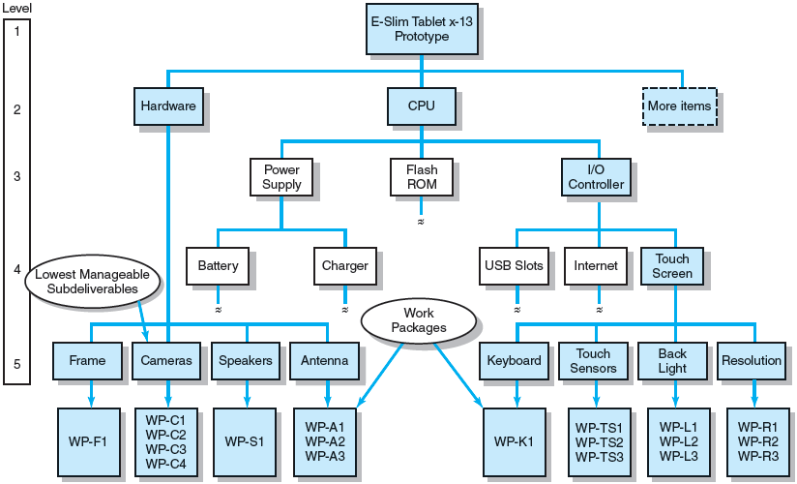
Work Breakdown Structure
FIGURE 4.4

Slide 19
Work Packages
A work package is the lowest level of the WBS.
It is output-oriented in that it:
Defines work (what).
Identifies time to complete a work package (how long).
Identifies a time-phased budget to complete a work package (cost).
Identifies resources needed to complete a work package (how much).
Identifies a person responsible for units of work (who).
Identifies monitoring points (milestones) for measuring success.

Slide 20
Step 4: Integrating the WBS with the Organization
Organizational Breakdown Structure (OBS)
Depicts how the firm is organized to discharge its work responsibility for a project.
Provides a framework to summarize organization work unit performance.
Identifies organization units responsible for work packages.
Ties organizational units to cost control accounts.

Slide 21
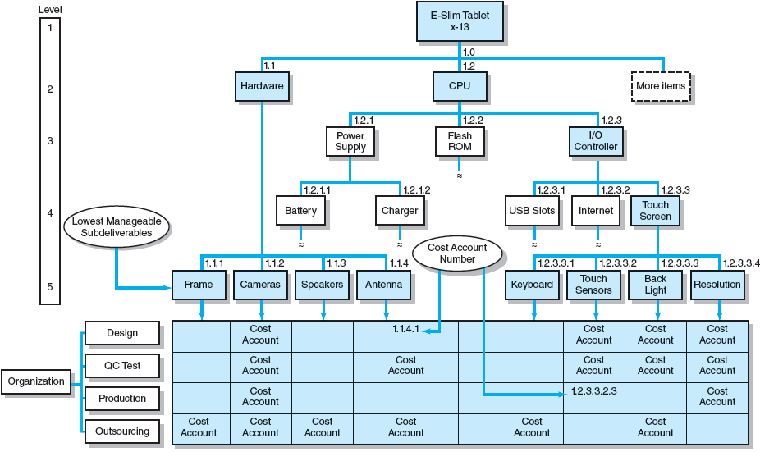
Integration of WBS and OBS
FIGURE 4.5

Slide 22
Step 5: Coding the WBS for the Information System
WBS Coding System
Defines:
Levels and elements of the WBS
Organization elements
Work packages
Budget and cost information
Allows reports to be consolidated at any level in the organization structure

Slide 23
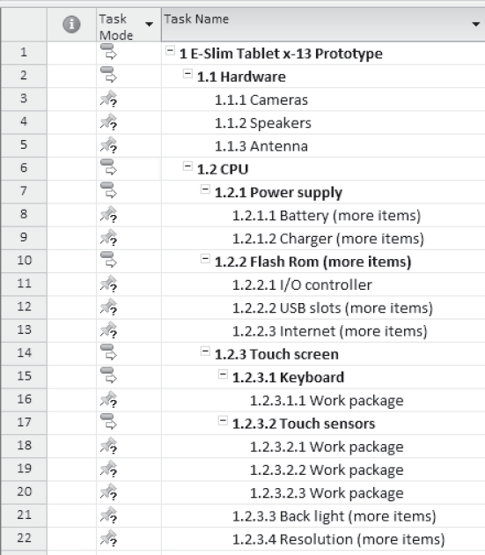
Coding the WBS
EXHIBIT 4.5

Slide 24
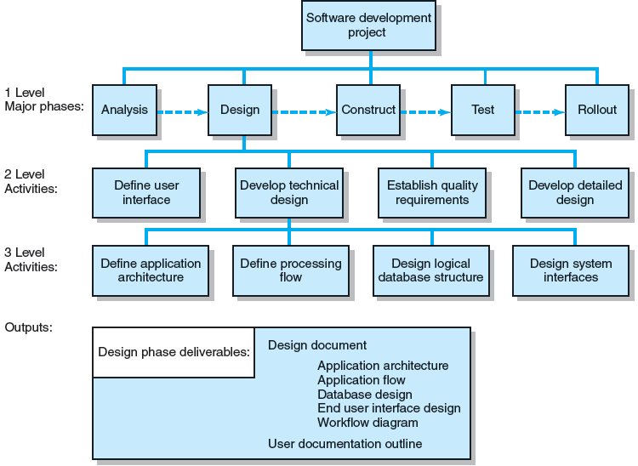
PBS for Software Development Project
FIGURE 4.6

Slide 25
Responsibility Matrices
Responsibility Matrix (RM)
Also called a linear responsibility chart.
Summarizes the tasks to be accomplished and who is responsible for what on the project.
Lists project activities and participants.
Clarifies critical interfaces between units and individuals that need coordination.
Provide an means for all participants to view their responsibilities and agree on their assignments.
Clarifies the extent or type of authority that can be exercised by each participant.

Slide 26
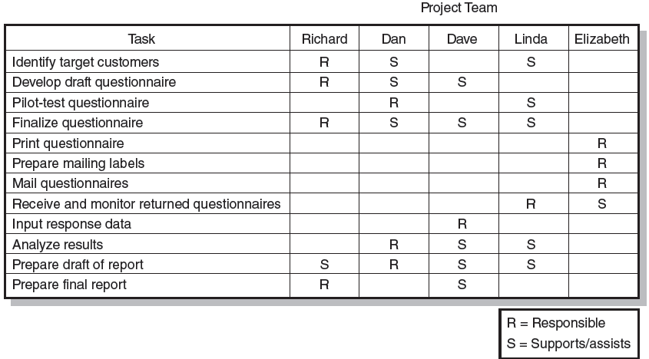
Responsibility Matrix for a Market Research Project
FIGURE 4.7

Slide 27
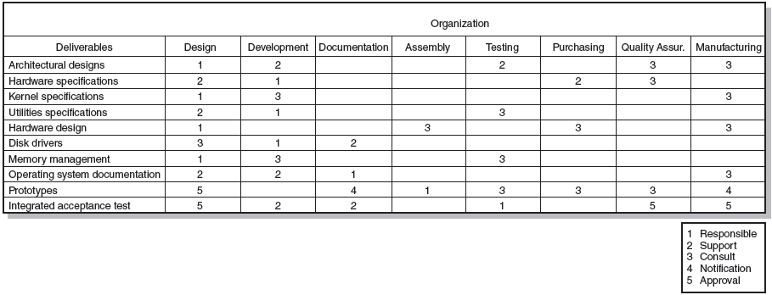
Responsibility Matrix for the Conveyor Belt Project
FIGURE 4.8

Slide 28
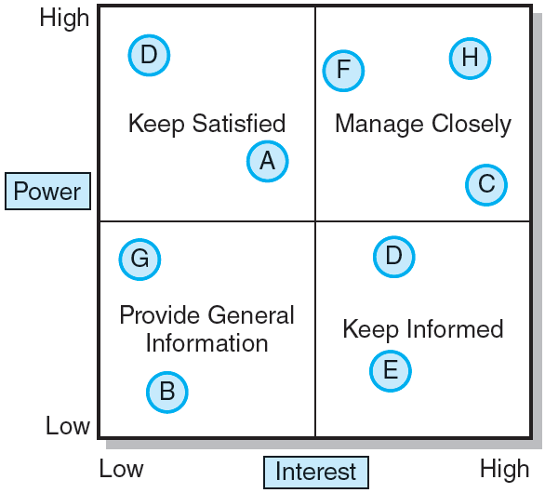
Stakeholder Communications
FIGURE 4.9

Slide 29
Project Communication Plan
What information needs to be collected and when?
Who will receive the information?
What methods will be used to gather and store information?
What are the limits, if any, on who has access to certain kinds of information?
When will the information be communicated?
How will it be communicated?

Slide 30
Information Needs
Project status reports
Deliverable issues
Changes in scope
Team status meetings
Gating decisions
Accepted request changes
Action items
Milestone reports

Slide 31
Developing a Communication Plan
Stakeholder analysis
Information needs
Sources of information
Dissemination modes
Responsibility and timing

Slide 32
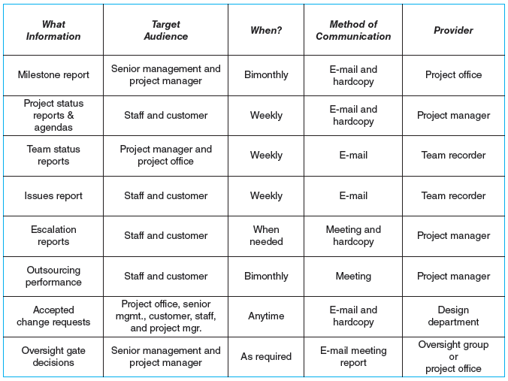
Shale Oil Research Project Communication Plan
FIGURE 4.10

Slide 33
Key Terms
Cost account
Milestone
Organization breakdown structure (OBS)
Priority matrix
Process breakdown structure (PBS)
Project charter
Responsibility matrix
Scope creep
Scope statement
WBS dictionary
Work breakdown structure (WBS)
Work package

